Slide 1

2022
Health Track
Fitness APP
Developers
Longchao Da, Winona Patrick, Rohan Chopra, Khushali Sheth, Rutva Gandhi, Vinoothna Yarlagadda, Hao Mei
.

Slide 2
Product Backlog (PBL)
— HealthTrack

Slide 3
Overview of Fitness APP
ID/# | Actor | Activity /User Story | Value | Notes | Rank | Estimate [Story Points or Ideal Hours]
 | As… | I want functions like… | So that… | 1sp=3ideal hour |  | sum = [94sp]=282h
1 | Customer | Customer information collection (weight loss goal, age, weight, height, etc) - put into database |  | 1 | 1 | 3sp
2 |  | Track calories of food items - put into database |  |  | 4 | 15 sp
3 |  | Community features: forum, challenges |  |  | 5 | 17 sp
4 |  | Reward system - award badges for achieving goals |  |  | 3 | 7 sp
5 |  | Recommendation system - custom meal and exercise plans |  |  | 2 | 22 sp
6 |  | reminder system - notify customers to finish their daily goals |  |  | 6 | 10 sp
7 |  | Back-end data analysis system |  |  | 7 | 20 sp
Testing extra: 20% * 282 = [19sp]57h
Total: sum+extra = [113sp]339h

Slide 4
Sprint 1: Customer Information collection (Vinoothna)
ID/# | Actor | Activity /User Story | Value | Notes | Rank | Estimate [Story Points or Ideal Hours]
 | As… | I want functions like… | So that… | 1sp = 3 ideal hours |  | sum = 9sp
1 | Customer | information collection (goal, age, weight, height, etc) - table |  |  |  | 2 sp
2 |  | Calculating maximum daily calorie intake |  |  |  | 2sp
3 |  | Provide custom Workout Routine based on Body type |  |  |  | 3sp
4 |  | Measuring physical activities for Rewards |  |  |  | 2sp
Use case 4

Slide 5
Sprint 1: Back-end data analysis system(Longchao Da)
ID/# | Actor | Activity /User Story | Value | Notes | Rank | Estimate [Story Points or Ideal Hours]
 | As… | I want functions like… | So that… |  |  | Sum=20sp
1 | Customer | User distribution analysis(gender, location) |  |  |  | 2 sp
2 |  | User amount incremental analysis(register, subscribe) |  |  |  | 1 sp = 3 ideal hours
3 |  | User demand/goal understanding |  |  |  | 1 sp
4 |  | Data Mining on the recommending dependencies |  |  |  | 3 sp
5 |  | Visualization of user distributed map |  |  |  | 3 sp
6 |  | Access to manage the users (add/delete/lock) |  |  |  | 2 sp
7 |  | Violation information detection function (text/audio/avatar) |  |  |  | 4 sp
8 |  | Abnormal account alert (fraud/stolen account) |  |  |  | 4 sp

Slide 6
Sprint 2: Track User Calories (Khushali)
ID/# | Actor | Activity /User Story | Value | Notes | Rank | Estimate [Story Points or Ideal Hours]
 | As… | I want functions like… | So that… | 1sp =3 hours |  | Sum=9sp
1 | Customer | Home page that contains calories summary |  |  |  | 3 sp
2 |  | Journal page - log food calorie information |  |  |  | 3sp
3 |  | Barcode scan feature to enter calories and manual calorie entry feature |  |  |  | 3sp
Use case 2

Slide 7
Sprint 3: Community[motivation, activities](Rohan)
ID/# | Actor | Activity /User Story | Value | Notes | Rank | Estimate [Story Points or Ideal Hours]
 | As… | I want functions like… | So that… | 1sp = 3 ideal hours |  | Sum:16sp
1 | Customer | Forum page functions - posting, commenting, upvoting, post history |  |  | 1 | 5 sp
 |  | Transformation Stories - users can post their transformation pictures in FORUM PAGE
2 |  | Host challenges ( pushups, pullups, squats, and so on rewarded with FitCoins to be used for shopping) |  |  | 6 | 4 sp
3 |  | Informational Posts by Experts on wellbeing (nutrition, workout, mental health and so on) with filters based on your goals and interests - in FORUM PAGE |  |  | 4 | 3 sp
5 |  | Q/A and Discussion in FORUM PAGE |  |  | 3 | 2 sp
6 |  | Recipes in FORUM PAGE |  |  | 2 | 2 sp
Use Case 6

Slide 8
Sprint 4: Reward system(Winona)
ID/# | Actor | Activity /User Story | Value | Notes | Rank | Estimate [Story Points or Ideal Hours]
 | As… | I want functions like… | So that… |  |  | Sum=9sp
1 | Customer | Badge design |  |  |  | 3sp
2 |  | What should the rewards be for? Most cal burned, longest workout, etc |  |  |  | 1 sp
3 |  | Badges for special events |  |  |  | 2 sp
4 |  | Leaderboard board for specific badge types (ex: most cals burned in a running workout) |  |  |  | 3 sp
Use Case 3

Slide 9
Sprint 5: Recommendation system(Hao Mei)
ID/# | Actor | Activity /User Story | Value | Notes | Rank | Estimate [Story Points or Ideal Hours]
 | As… | I want functions like… | So that… |  | 1 sp = 3 ideal hours | Sum= 22sp
1 | Customer | browsing and displaying the articles (front) |  |  | 1 | 3sp
2 |  | video displaying page (front) |  |  | 2 | 3sp
3 |  | upload the media sources (back) |  |  | 4 | 4sp
4 |  | recommendation algorithms (data) |  |  | 6 | 6sp
5 |  | recommendation adjustment and settings |  |  | 5 | 2sp
6 |  | content management |  |  | 7 | 2sp
7 |  | content interaction (like/mark/tag/download) |  |  | 3 | 2sp
8
Use case 7

Slide 10
Sprint 6: Reminder system(Rutva)
ID/# | Actor | Activity /User Story | Value | Notes | Rank | Estimate [Story Points or Ideal Hours]
 | As… | I want functions like… | So that… |  | 1 sp = 3 ideal hours | Sum= 5 sp
1 | Customer | Be able to change/set reminders |  |  |  | 2 sp
3 |  | Rise & shine, Getup & move (Daily reminder) |  |  |  | 1 sp
4 |  | Reminder to input calories for food items |  |  |  | 1 sp
5 |  | Complete exercise goal reminder |  |  |  | 1 sp
Use case 5

Slide 11
Overview Context Diagram(informal)
— HealthTrack

Slide 12
HealthTrack-informal overview-context diagram v1
Shops
Register as shops
Upload the goods items
Receive the orders from users
Front-end Users
Shop
features
Register/Login API
Display Exercise Videos
Portal of Community
Portal to Self Information
Track nutrients (Scan/Input)
Portal of notification Messages
Entrance of recommend Info
Reward Sys (badge, coupons)
Reminder settings
Front-end
features
Backend Manager
Back-end
Features
Conduct data analysis on user increment
Visualize the user distribution
Exercise type ranking
Send system notifications
Send recommended articles
Information validation/ sensitive info check/ Lock users
Interest analysis, etc.
Bank
features
Banks
Payment validation
Regular pay subscribe
Abnormal payment action detection

Slide 13
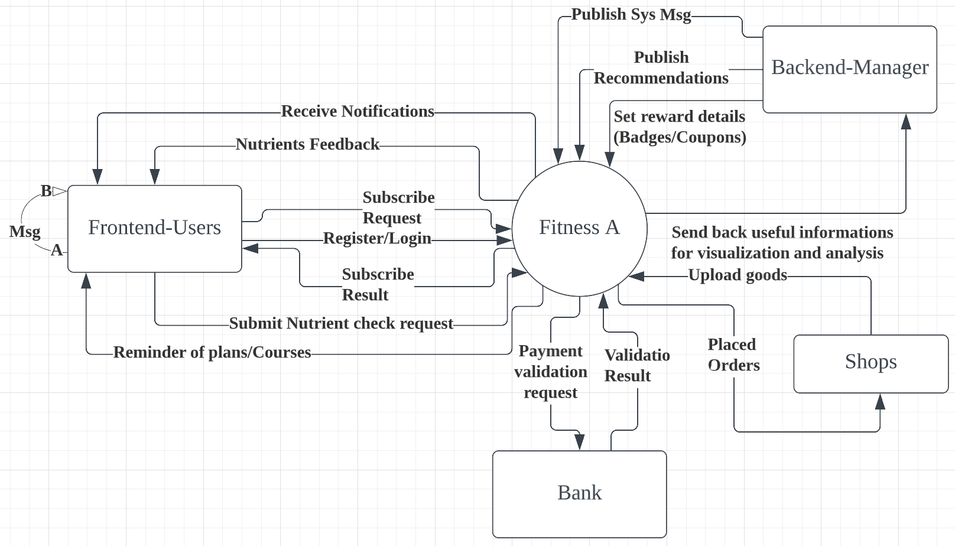
HealthTrack-informal overview-context diagram v2

Slide 14
System-level Context Diagram(functional segments)
— HealthTrack

Slide 15
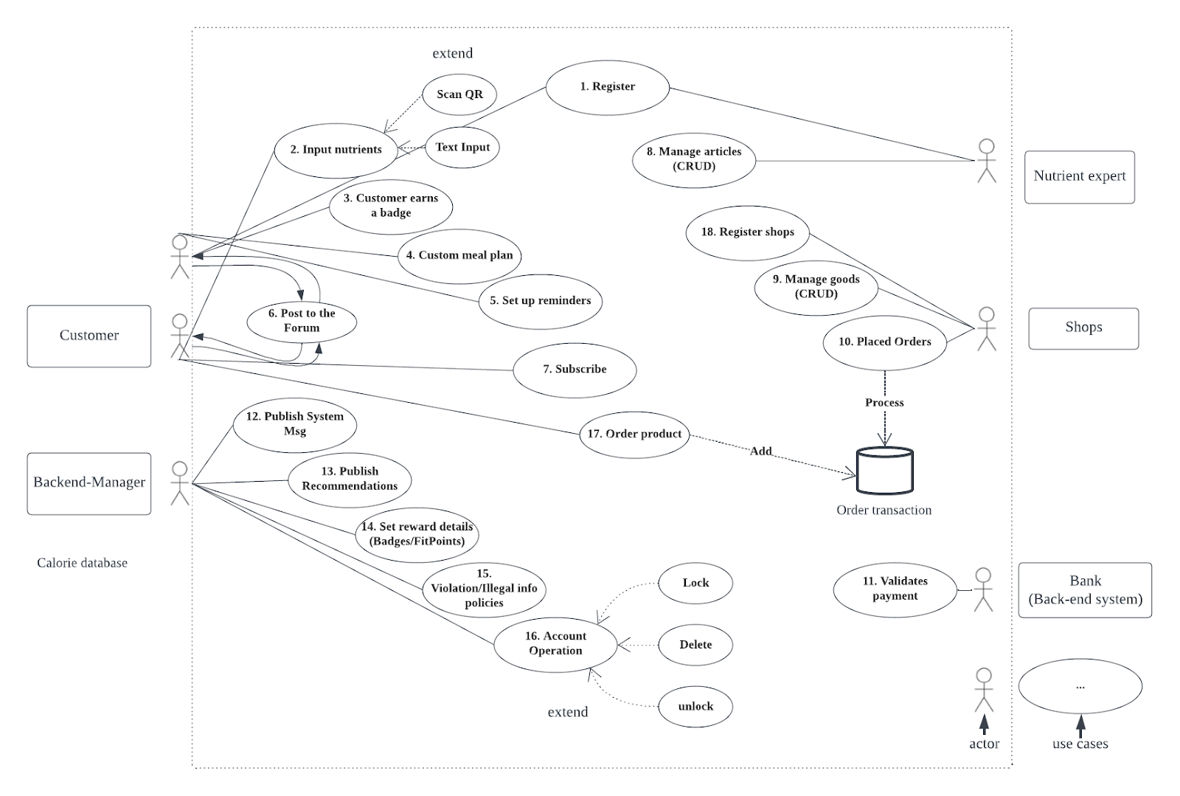
System level Use Case model
System boundary

Slide 16
Use Case Example(more information)
— HealthTrack

Slide 17
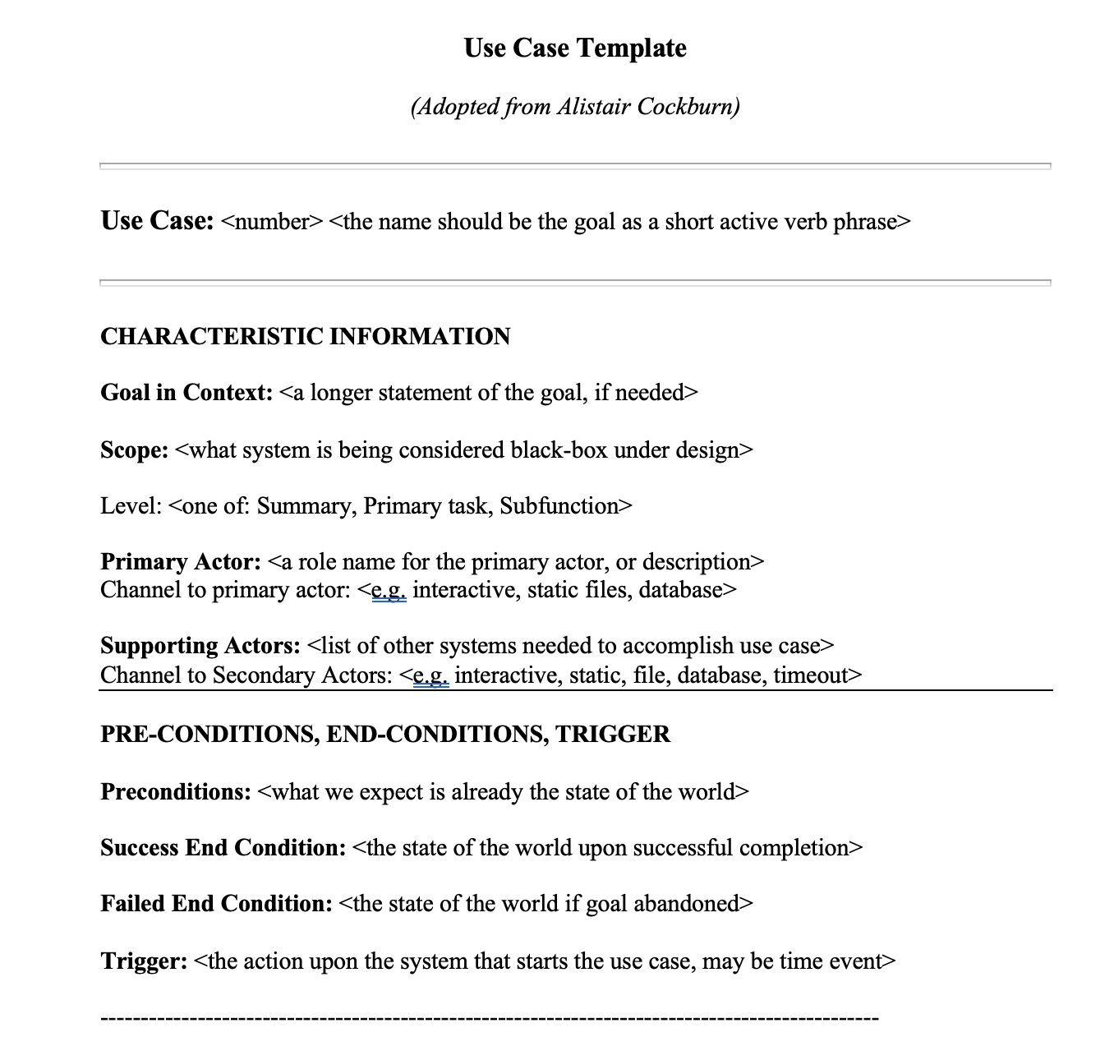
System level Use Case model
System boundary

